Slide 1


True Benefit of Electric Vehicles
Team: Richard, Abdoul, Mandler, Alexandra, Zac
Is the movement towards electric vehicles truly a benefit
To the planet and people (2015 – 2018)
Questions to answer:
What is/has been the impact on Carbon Dioxide emissions? – Mandler, Alex
Who owns Evs? – Abdoul, Zac
Does one type of climate provide better conditions for EV ownership vs total car sales? – Richard, Zac
Datasets and APIs
Census, Google Maps, OpenWeatherMap, Alliance for Automotive Innovation

Slide 2
Electric Vehicles
Impact on Carbon Emissions
Census data v median household income
Regional climates and EV sales

Slide 3
Ownership vs Census Data
Median household income of families with EV
What areas own the most (Cost of Living)

Slide 4
EVs Sold vs Ave Median Household Inc

Slide 5
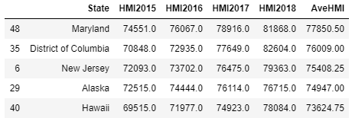
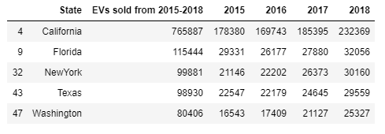
Top 5 States in Sales and Median Household Income
Top 5 lists do not share any common states
No perceived correlation between state HMI and Evs owned

Slide 6
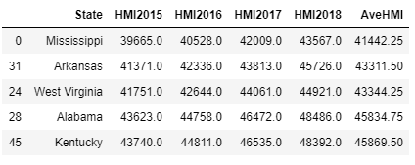
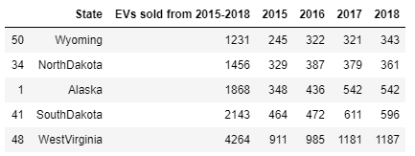
Bottom 5 States in Sales and Median Household Income
Bottom 5 lists do not share any common states
No perceived correlation between state HMI and Evs owned
Notes:
Scatter plot is deceiving as 50/51 states are clustered in a nice linear format (California being the exception)

Slide 7
Take Aways
Move from analyzing based on State level to City/County level.
Rural vs Urban areas could have a drastic difference in HMI and EV ownership
California as an outlier is affecting the trend, still positive, but not as drastic as scatter plot indicates

Slide 8
Car Sales vs Weather Conditions
Do prevailing weather conditions impact EV sales
What weather conditions predominate EV population

Slide 9
Impact of Carbon Emissions
Has the sale of EVs lowered Carbon Emissions?
If so, by how much?
Has the production of electricity raised Carbon Emissions?

